Slide 1
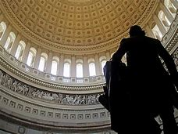
Being a Veterans’ Advocate
VFW National Legislative Service

Slide 2
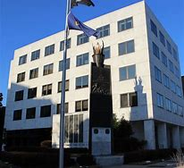
Our Guiding Principle for Activism
All politics is local
Your influence counts, so use it!

Slide 3
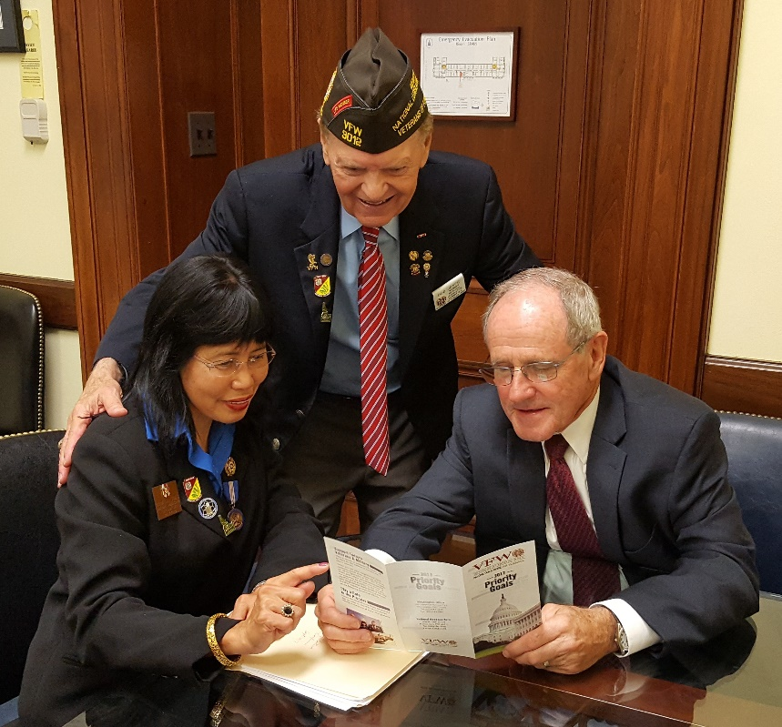
Legislative Advocate Job Responsibilities
Be the face of the VFW for Congress
- Build relationships with members and their staff
- Be the veteran they turn to for ideas and answers

Slide 4
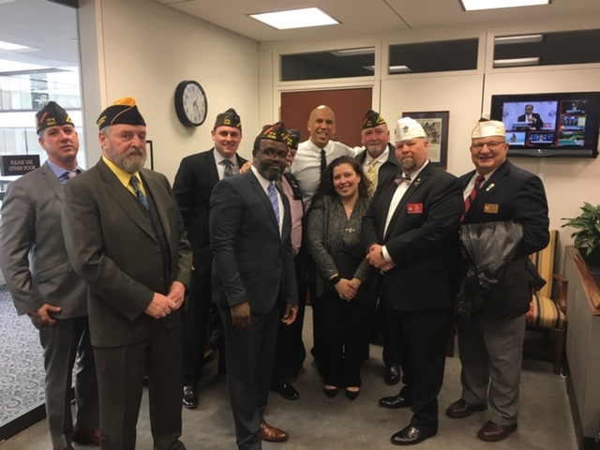
Legislative Advocate Job Responsibilities
Coordinate involvement
- Respond to Action Alerts
- Recruit others to be involved in:
Action Corps- passive
Grassroots POC- active
- Promote attendance at
Town Hall meetings
Campaign stops

Slide 5
Political Activities:
VFW members can make a difference in any election by getting involved in the political process. Here are a few items to keep mind as you get involved and attend or host candidate functions and town hall meetings:
DO’s
Attend candidate town hall meetings and other events and ask candidates where they stand on our issues.
Set up voter registration drives /Get Out the Vote Campaigns on the local level.
Provide carpool service on Election Day to help the elderly and disabled get to the voting booth.
Support and work for your favorite candidates as an individual voting constituent.
Wear your VFW cap at public events such as town halls, rallies, forums, or debates.

Slide 6
Political Activities:
DON’Ts
Don’t endorse candidates on behalf of the VFW National Organization, Department, District or Post.
Don’t wear your VFW cap when actively campaigning for a candidate, such as soliciting donations or knocking on doors asking people to pledge their vote for a candidate.

Slide 7
You can contact the National Legislative Service anytime with questions.
vfwac@vfw.org or 202-608-8372
Thank you for all that you do!

